Slide 1
Preprinting and Publishing in the Life and Biomedical Sciences
I: Introduction to the evolving publication landscape

Slide 2





In today’s lesson we will discuss:
The importance of communication in scientific progress
The history of scientific communication and how the current traditional, journal-based publication process works
Challenges within the current publication system
Emerging solutions and innovations in scientific communication and how new models integrate with the traditional publication process
Introduction to lessons and goals of the course

Slide 3
Things you should know:
What is a ‘research article’? As scientists, we share our work through written ‘research articles’ that describe the rationale for our study, the methods we used, the results of our experiments, and the interpretation of our findings.
What is ‘publishing’? ‘Publishing’ is a process in which a written work is evaluated, edited, and prepared to be released to the public as a ‘publication’.
What is a ‘scholarly journal’? Research articles are submitted to ‘scholarly journals’ to be evaluated by ‘editors’ and prepared for publication.
What is ‘peer review’? Prior to publication, ‘research articles’ are ‘peer-reviewed’, i.e., assessed by other scientists relevant the field for ‘quality’, ‘validity’, and ‘originality’ of the scientific work.
Publication of research articles in scholarly journals is currently the primary method for scientists to communicate their research findings to other scientists.
Notes:
https://authorservices.wiley.com/Reviewers/journal-reviewers/what-is-peer-review/index.html

Slide 4
How do we achieve scientific progress?

Slide 5





Investigation
Evidence
Cycle of
Scientific Discovery
Communication
New Cycles of Scientific Discovery
Scientific Community
Natural Life
Interpretation
Feedback & Critique
Scientific progress is a collective endeavor

Slide 6
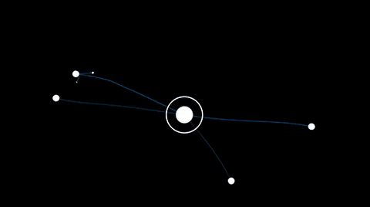
Communication is central to scientific progress
Your scientific discovery
🤔 More communication = More scientific progress?

Slide 7
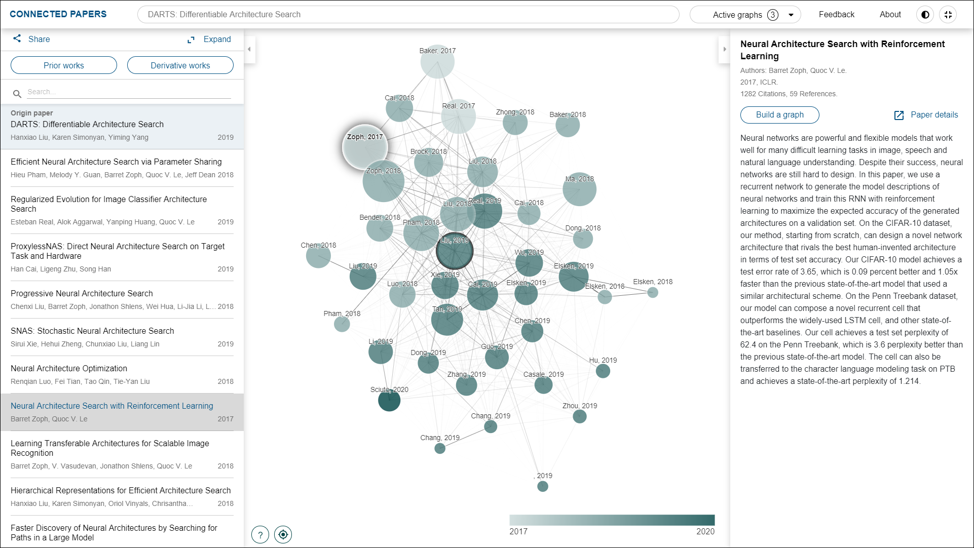
Connected papers exercise
Go to www.connectedpapers.com
Insert an identifier of your favorite paper (Title, DOI, etc)
Build a network graph of your favorite paper!
See the ‘prior works’ that formed the basis of your favorite paper and the impact of it in ‘derivative’ works
Notes:
https://www.connectedpapers.com/
Exercise for the educator or for students to see a network visualization of a relevant paper to their field, research, etc. May contextualize the concepts of research as a collective endeavour.

Slide 8
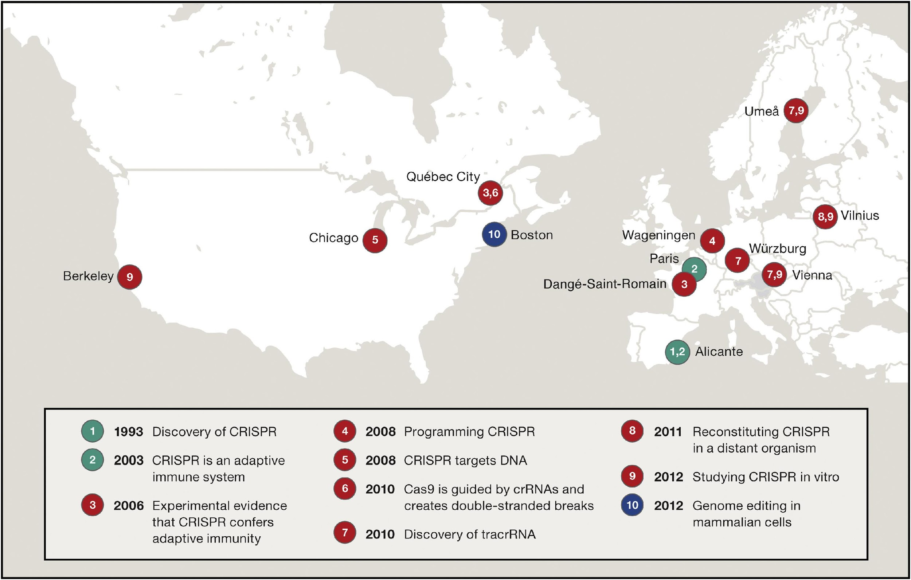
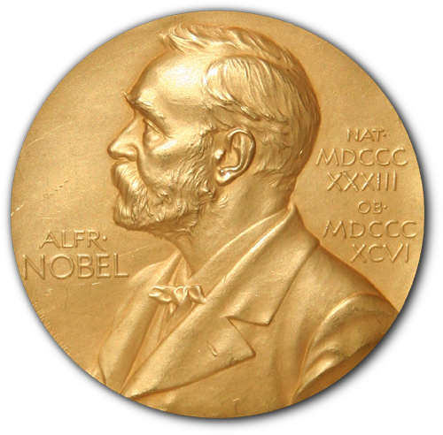

Scientific progress requires communication over space and time
Path to the CRISPR Gene Editing Revolution
2020
Nobel prize awarded to Jennifer Doudna and Emmanuelle Charpentier
Notes:
Effective communication over time and space is required for scientific breakthroughs
https://doi.org/10.1016/j.cell.2015.12.041

Slide 9
How have we communicated our science throughout history?

Slide 10

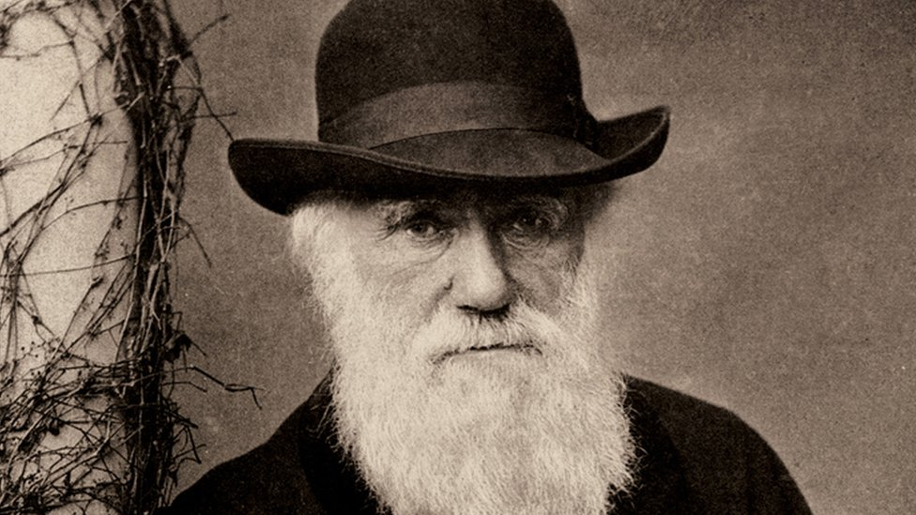

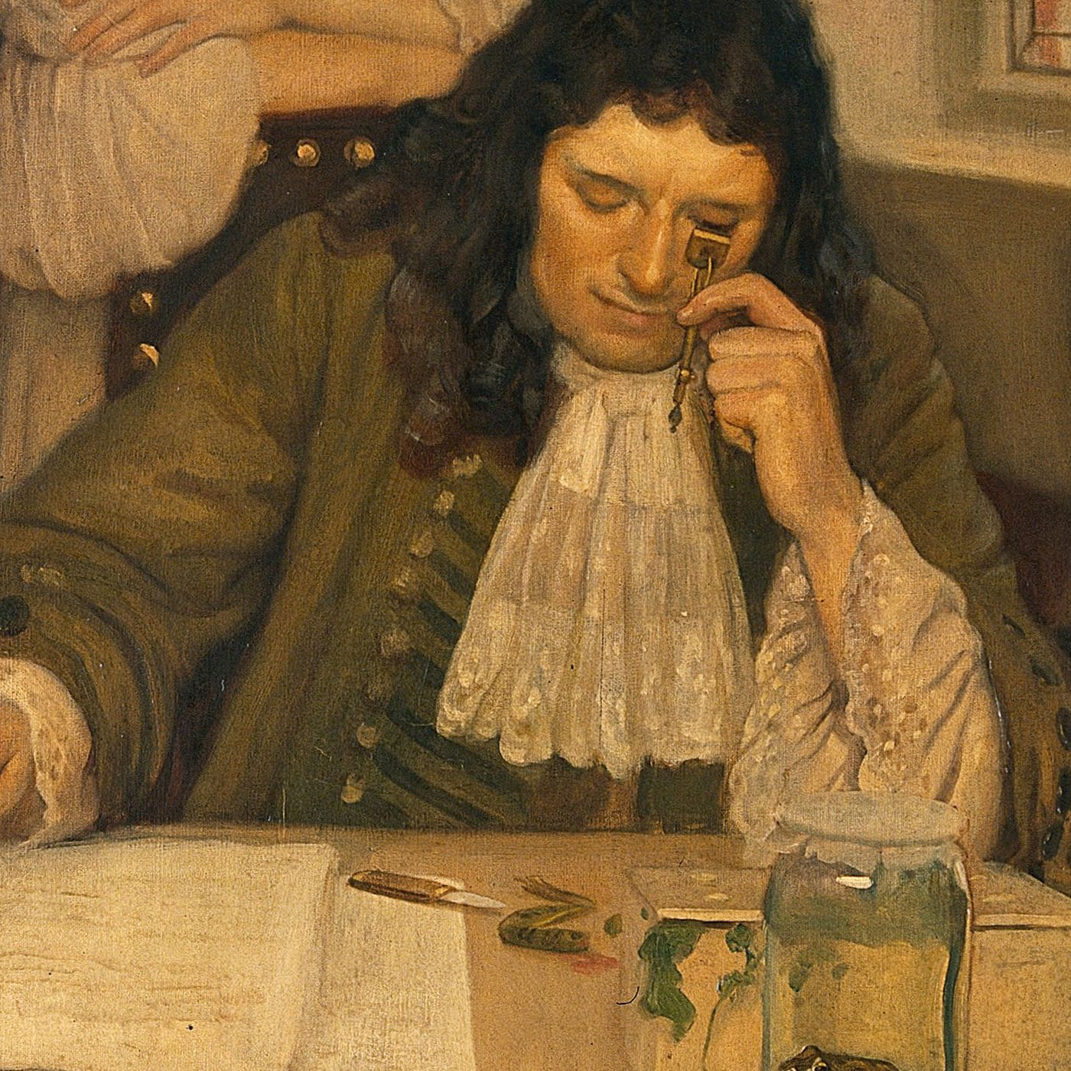
Origins and evolution of the academic journal
Prior to journals, communication was largely through individual letters and conversation through learned societies
17th Century – The journal as a “centralized” form of communication
FUN FACT: Philosophical Transactions of the Royal Society of London’s Henry Oldenburg was not merely editor, but also author, translator, and reviewer
First two scientific journals:
Journal des Sçavans and
Philosophical Transactions of the Royal Society of London
1665
Notes:
Philosophical Transactions published famous scientists such as Newton, Hooke, van Leeuwenhoek, Faraday, and Darwin.

Slide 11
Origins and evolution of the academic journal
18th Century – first fully peer-reviewed journal
FUN FACT: Formal journal-dependent peer review was not widely accepted until after WWII (>1945)
Medical Essays and Observations, the first fully peer-reviewed journal
1731
First two scientific journals:
Journal des Sçavans and
Philosophical Transactions of the Royal Society of London
1665
Notes:
https://blogs.scientificamerican.com/information-culture/the-birth-of-modern-peer-review/

Slide 12
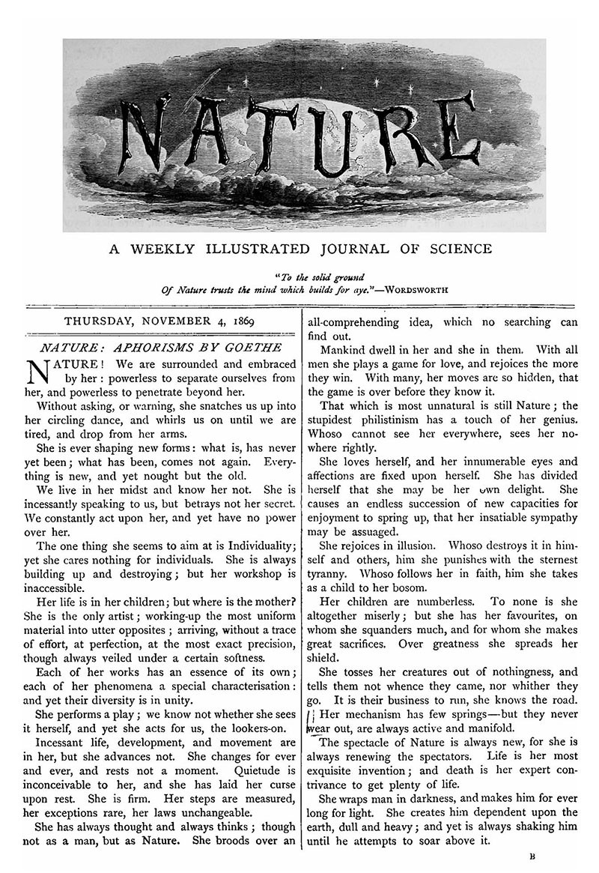
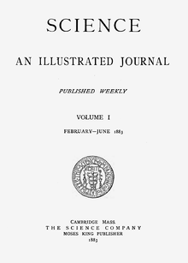
Origins and evolution of the academic journal
19th Century – Thousands of journals come on the scene, most funded publicly through learned societies, as well as some commercial publishers
Medical Essays and Observations, the first fully peer-reviewed journal
1731
Nature publishes its first issue.
1869
First two scientific journals:
Journal des Sçavans and
Philosophical Transactions of the Royal Society of London
1665
Science publishes its first issue.
1880

Slide 13
Origins and evolution of the academic journal
20th Century - Boom in scientific funding and academic research following WWII
Internationalization of publishing
Commercial publishing becomes a highly profitable industry
Journal-dependent peer review is widely adopted
Experimental efforts for open scientific communication models hit roadblocks (IEGs)
“Digital age” opens avenues for online journals
Information Exchange Groups experiment at the NIH (USA)
1961-1967
Medical Essays and Observations, the first fully peer-reviewed journal
1731
Elsevier launches its first international journal, Biochimica et Biophysica Acta.
1947
Nature publishes its first issue.
1869
First two scientific journals:
Journal des Sçavans and
Philosophical Transactions of the Royal Society of London
1665
Postmodern Culture - first online-only journal
1990
Science publishes its first issue.
1880
Nature adopts peer review
1961

Slide 14





























Academic publishers and scientific journals Today…
….And many, many more
Business Models
Non-profit, subscription-based, Open-access optional ($$)
Non-profit, Open-access
For-profit/Commercial, subscription-based, Open-access optional ($$)
For-profit/Commercial, subscription-based, Open-access
Modalities
Online and print, Online only
Topical
General and field specific

Slide 15





Functions of academic journals have evolved beyond communication:
Archiving: permanently storing scholarship for later access.
Registration: time-stamping authors' contributions to establish precedence.
Dissemination: getting scholarly products out to scholars who want to read them.
Certification: assessing contributions and giving “stamps of approval.”
Research evaluation: define metrics to evaluate research “impact” of scientific works
Notes:
https://doi.org/10.3389/fncom.2012.00019

Slide 16
How does the traditional journal-based publication process currently work?

Slide 17
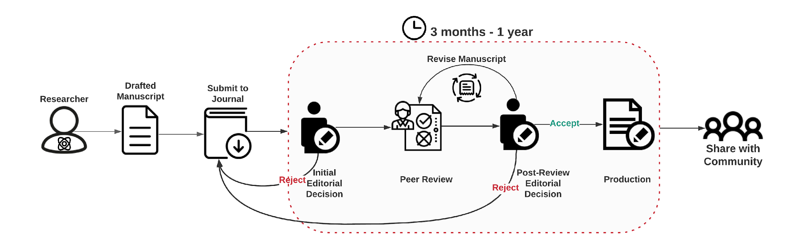
The traditional journal-based publication process
Notes:
Contextualize the process

Slide 18


Challenges in the traditional journal-based publication process
Author’s wait for publication to meet the unspoken standards of “high-impact” journals

Slide 19
Challenges in the traditional journal-based publication process
Editorial processes can be slow
Inefficient and ineffective peer review

Slide 20
Challenges in the traditional journal-based publication process
Post-review rejection starts the whole process over

Slide 21

Challenges in the traditional journal-based publication process
Costs for authors are high JUST to publish
Notes:
Time
- Author’s decisions to wait for publication to meet the unspoken standards of “high-impact” journals
Slow editorial process
Inefficient and ineffective peer review
Cost
Costs are high for authors just to publish – compounds with dismal funding for the actual research
Closed access for universities and public
If the time it takes to go through the publication process is unjustifiably slow, how does that impact scientific progress?
If peer review is ineffective, how does that impact scientific progress?
If publication and access is only privileged to those that can afford it, how does that impact scientific progress?

Slide 22
Challenges in the traditional journal-based publication process
Costs are high for access
Notes:
Time
- Author’s decisions to wait for publication to meet the unspoken standards of “high-impact” journals
Slow editorial process
Inefficient and ineffective peer review
Cost
Costs are high for authors just to publish – compounds with dismal funding for the actual research
Closed access for universities and public
If the time it takes to go through the publication process is unjustifiably slow, how does that impact scientific progress?
If peer review is ineffective, how does that impact scientific progress?
If publication and access is only privileged to those that can afford it, how does that impact scientific progress?

Slide 23
Unintended consequences…
If the time it takes to go through the publication process is unjustifiably slow…
If peer review is ineffective…
If publication and access is only privileged to those that can afford it…
If scientific careers and funding are dependent on an ineffective publication process…
How does this impact scientific progress?

Slide 24
Challenges in publishing with CRISPR
Pourcel et al., 2005
Rejected by:
PNAS
Journal of Bacteriology
Nucleic Acid Research
Genome Research
Published in Microbiology
Mojica et al., 2005
~1.5 years manuscript-ready > publication
Rejected by:
Nature – “key idea was already known”
PNAS – “lacked sufficient novelty and importance”
Molecular Microbiology
Nucleic Acid Research
Published in Journal of Molecular Evolution (1 year in review/revision)
Siksnys et al., 2012
~5 months manuscript-ready > publication
Rejected by:
Cell
Published in PNAS
Path to the CRISPR Gene Editing Revolution
2020
Nobel prize awarded to Jennifer Doudna and Emmanuelle Charpentier
Jinek et al., 2012
~20 days manuscript-ready > publication
Published in PNAS
Notes:
https://doi.org/10.1016/j.cell.2015.12.041

Slide 25
Emerging solutions and innovations: New models for scientific communication
“Digital age” facilitates innovation in open scientific communication
21st Century - Journals start experimenting with new forms of peer review, new business models, and new funding sources
Preprint servers offer new hope for open access
arXiv, the science pre-print server, is launched.
1991
Several innovative new journal models emerge, including
F1000 Research and eLife.
2012
PLOS ONE, the open-access megajournal begins publishing.
2006
BioRxiv launches
2013
Postmodern Culture becomes the first online-only journal
1990
MedRxiv launches
2019
Notes:
https://www.aje.com/arc/scholarly-publishing-brief-history/
https://zenodo.org/record/546100#.X9KiURNKjMI
https://onlinelibrary-wiley-com.ezproxy.nihlibrary.nih.gov/doi/pdf/10.1002/9781118620762.ch27
https://jamanetwork.com/journals/jama/article-abstract/202114

Slide 26
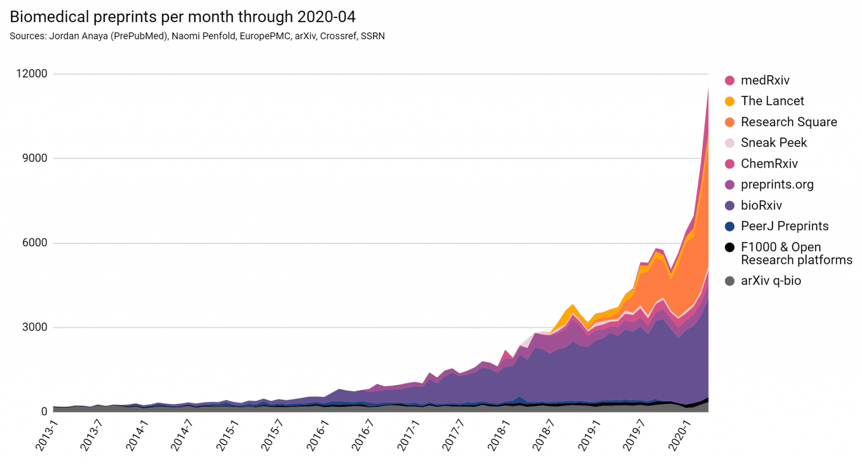









Adoption of preprinting in the life sciences
preprints on
preprints on
SciELO preprints
CrossRef indexes preprints
preprints on
Simons Foundation
Research Square
medRxiv
OSF preprints
supports bioRxiv
bioRxiv
preprints.org
PeerJ Preprints

Slide 27
Emerging solutions and innovations: New models for scientific communication
21st Century – Innovations in peer review emerge
Peer Community In
launches
2017
Peerage of Science
launches
2011
ReviewCommons launches
2019
PREreview
launches
2017
eLife Pre-print review launches
2021
arXiv, the science pre-print server, is launched.
1991
Several innovative new journal models emerge, including
F1000 Research and eLife.
2012
PLOS ONE, the open-access megajournal begins publishing.
2006
BioRxiv launches
2013
Postmodern Culture becomes the first online-only journal
1990
MedRxiv launches
2019
Notes:
https://www.aje.com/arc/scholarly-publishing-brief-history/
https://zenodo.org/record/546100#.X9KiURNKjMI
https://onlinelibrary-wiley-com.ezproxy.nihlibrary.nih.gov/doi/pdf/10.1002/9781118620762.ch27
https://jamanetwork.com/journals/jama/article-abstract/202114

Slide 28
Transitioning: How do new models integrate with the traditional publication process?

Slide 29
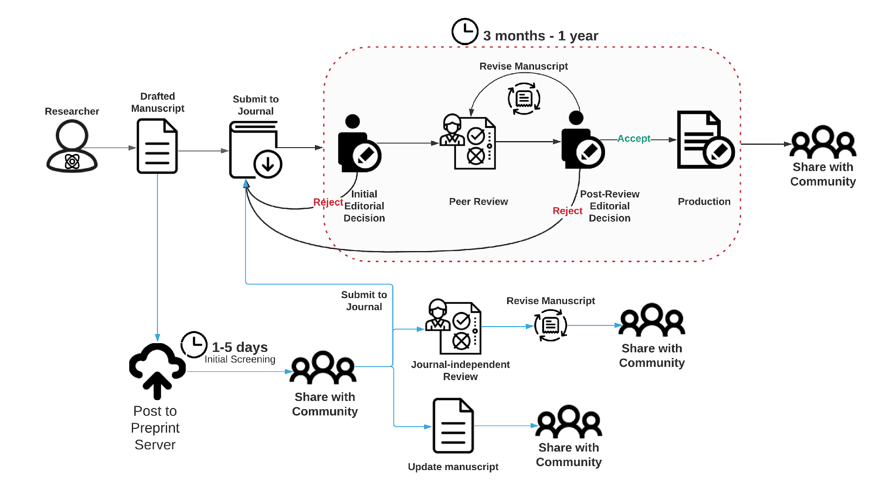
Preprinting + the traditional publication process

Slide 30
Preprinting solves some challenges in the traditional publication process
Authors have options to share their research
Immediate, FREE access
Early feedback from the community

Slide 31
Intro to the lessons: Preprinting and publishing in the life and biomedical sciences

Slide 32
Preprinting and publishing in the life and biomedical sciences
Lesson 2:
What is a preprint?
Top benefits and concerns of preprinting
A step-by-step guide for preprinting

Slide 33
Preprinting and publishing in the life and biomedical sciences
Lesson 3:
How do editors make decisions?
How does peer review work?
How to peer review: best practices

Slide 34
Preprinting and publishing in the life and biomedical sciences
Lesson 4:
Communicating your research through preprinting
Preprints and the public
Benefits and concerns of social media

Slide 35
Discussion #1
What has your experience been (good and bad) with the traditional, journal-based process?

Slide 36
Discussion #2
How might you design a communication process to advance scientific progress?
Notes:
Now that we have been introduced to the traditional journal-based publication process, how we got here, and its limitations

Slide 37
References
https://doi.org/10.1016/j.cell.2015.12.041
https://blogs.scientificamerican.com/information-culture/the-birth-of-modern-peer-review/
https://www.aje.com/arc/scholarly-publishing-brief-history/
https://zenodo.org/record/546100#.YAgV3ZNKjMJ
https://doi.org/10.1002/9781118620762.ch27
https://jamanetwork.com/journals/jama/article-abstract/202114
https://doi.org/10.3389/fncom.2012.00019

